Slide 1
Household Energy
Usage Forecast
By R. Boneys Dharan

Slide 2

Problem Statement:
In the modern world, energy management is a critical issue for both households and energy providers. Predicting energy consumption accurately enables better planning, cost reduction, and optimization of resources. The goal of this project is to develop a machine learning model that can predict household energy consumption based on historical data. Using this model, consumers can gain insights into their usage patterns, while energy providers can forecast demand more effectively.
Business Use Cases:
Monitor energy usage, reduce bills, and
promote energy-efficient habits.
Predict demand for better load management
and pricing strategies.
Identify irregular patterns indicating faults.
Enable predictive analytics for real-time energy optimization.

Slide 3

Objective: To explore Household energy usage data and predict global active power consumption from the data by doing deep learning and neural network analysis and gain valuable insights from visualization of data

Slide 4
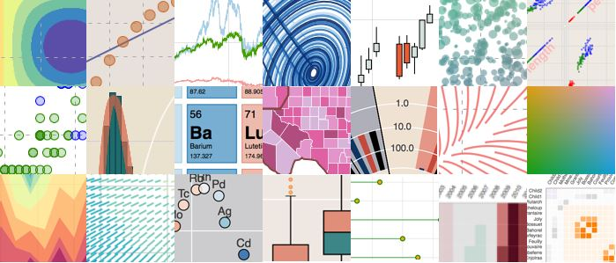

Concepts Used:
Python
Data Visualization
Data Extraction
Streamlit
Deep learning
Neural Network
Libraries Used:
Pandas
Streamlit
Plotly
Sklearn
Torch
Software Tools Used:
Visual Studio Code

Slide 5
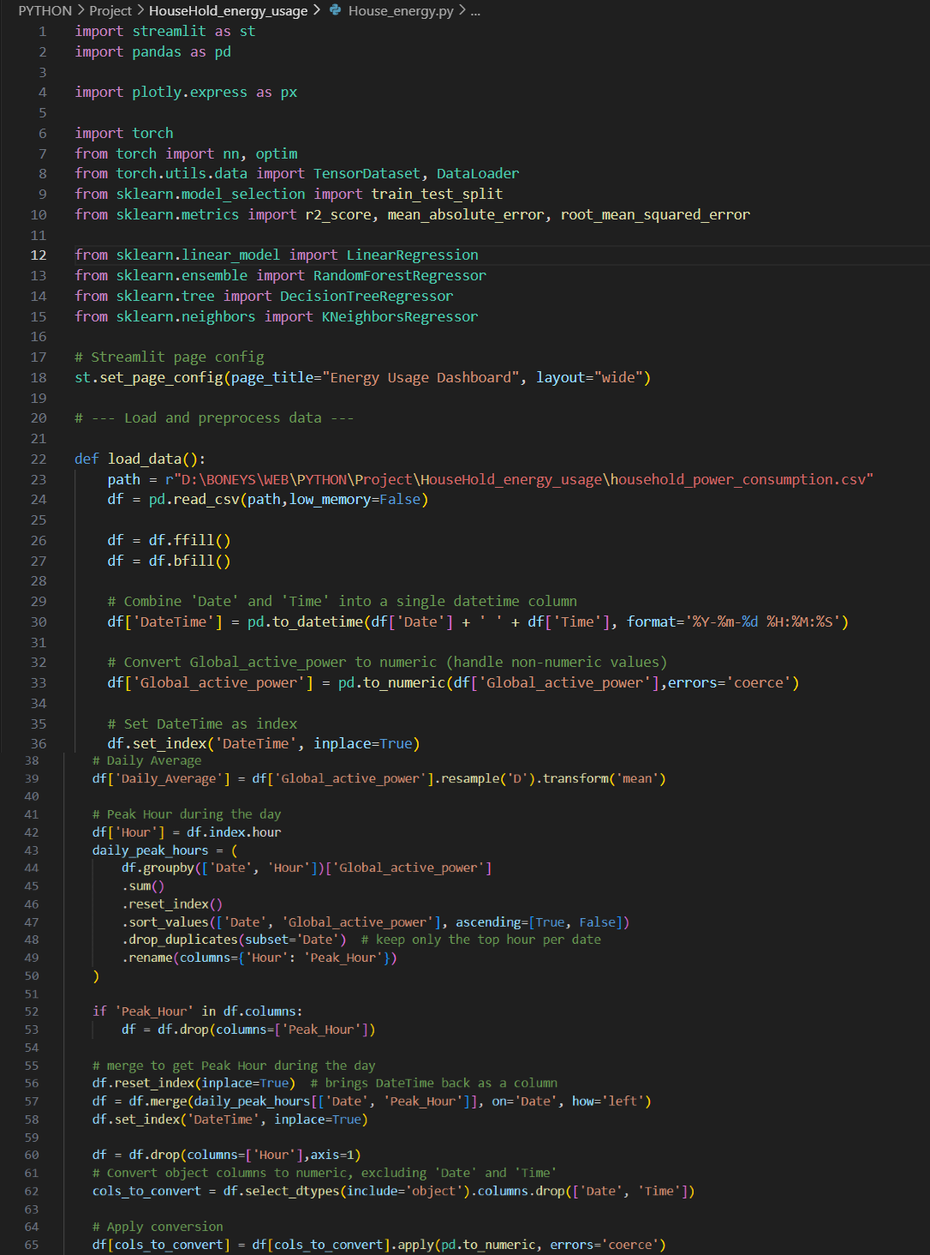
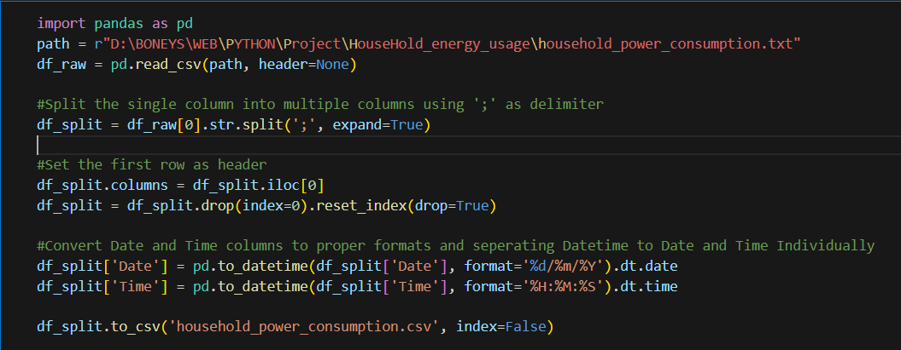
Code:
Importing required libraries
Loading data
Adding columns for better analysis
Converting columns to numeric for model evaluation
Text file to CSV file conversion:

Slide 6
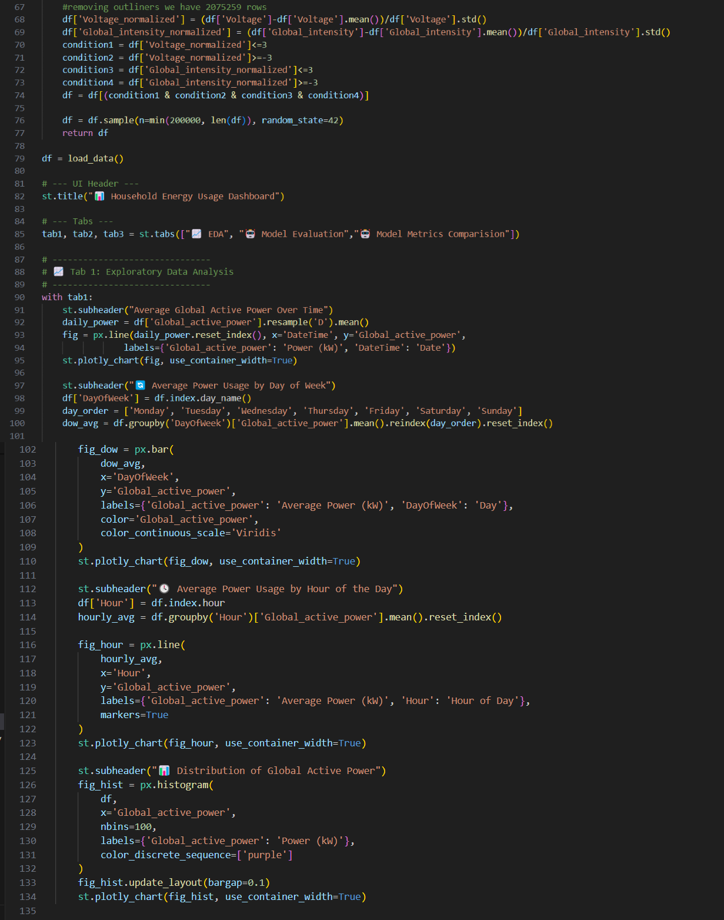
Code:
Removing outliners from data.
Performing Exploratory Data Analysis.

Slide 7
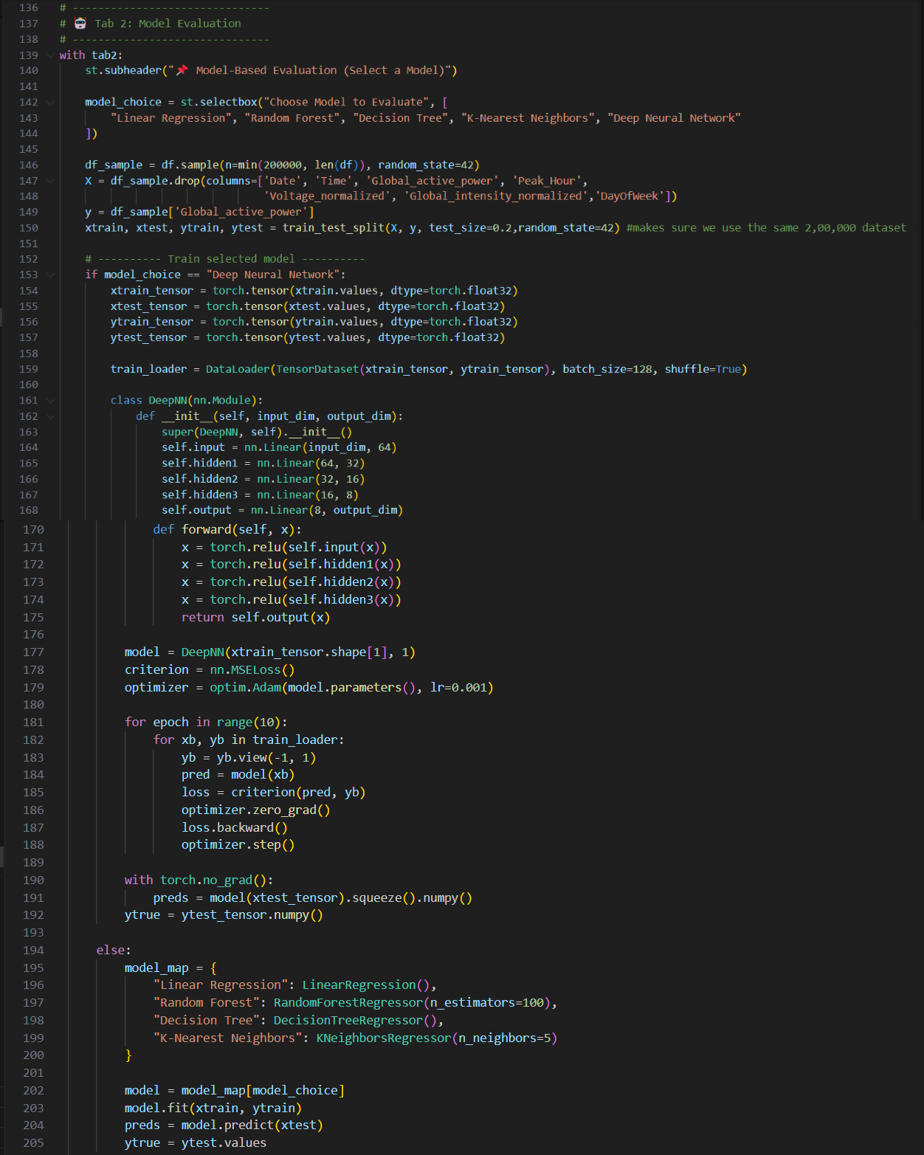
Code:
Creating training and test data
Implementing deep learning models.
Training model.
Predicting using model.

Slide 8
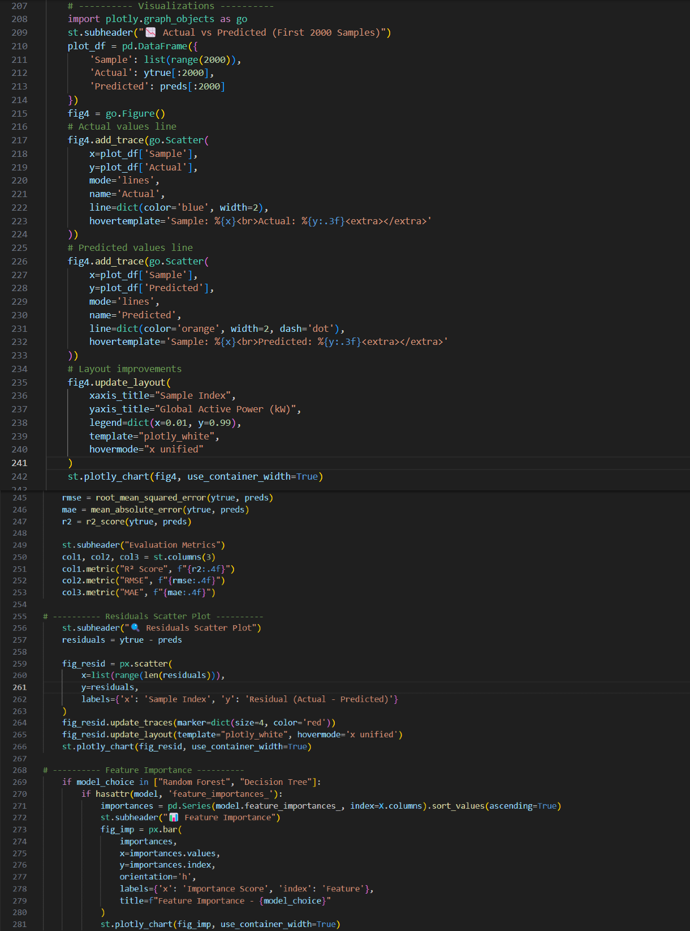
Code:
Visualizing actual vs predicted values.
Viewing metrics for selected model.
Plotting Residuals.

Slide 9
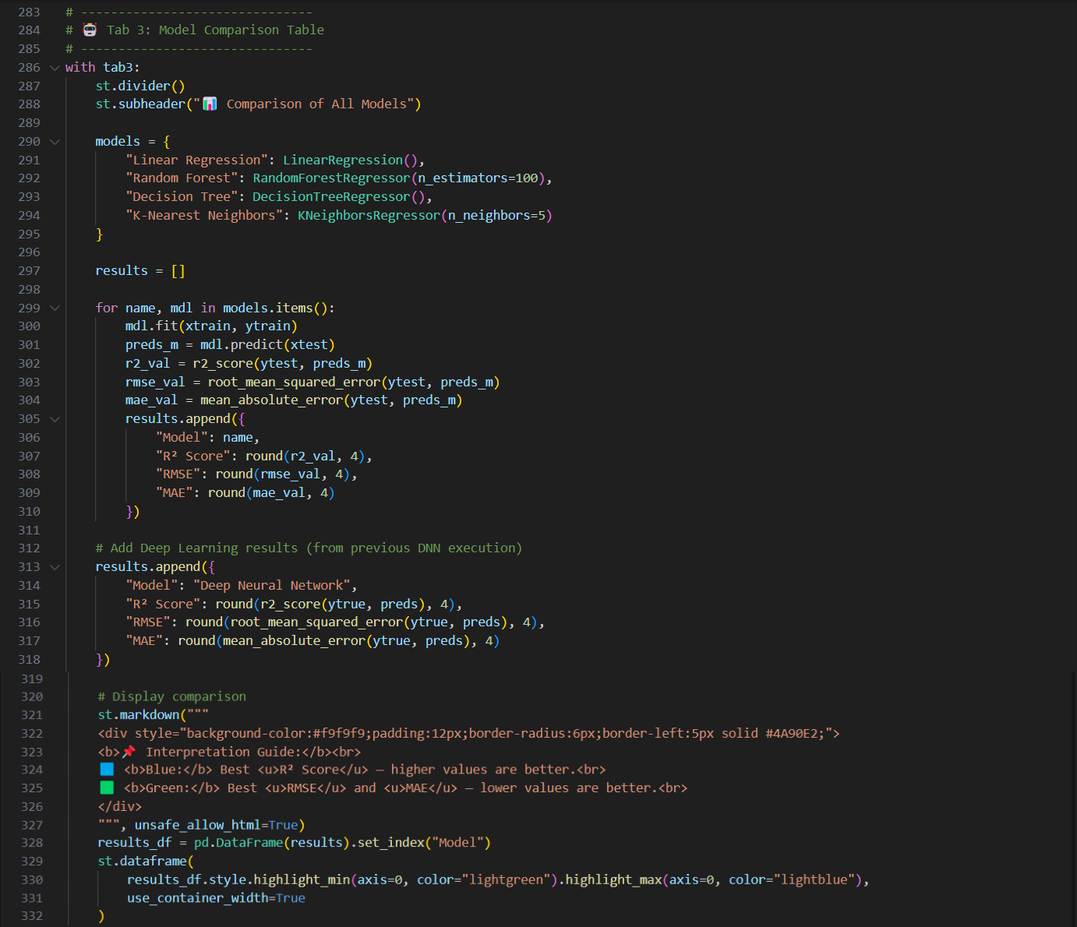
Code:
Comparing all models performance.
Plotting metrics.

Slide 10
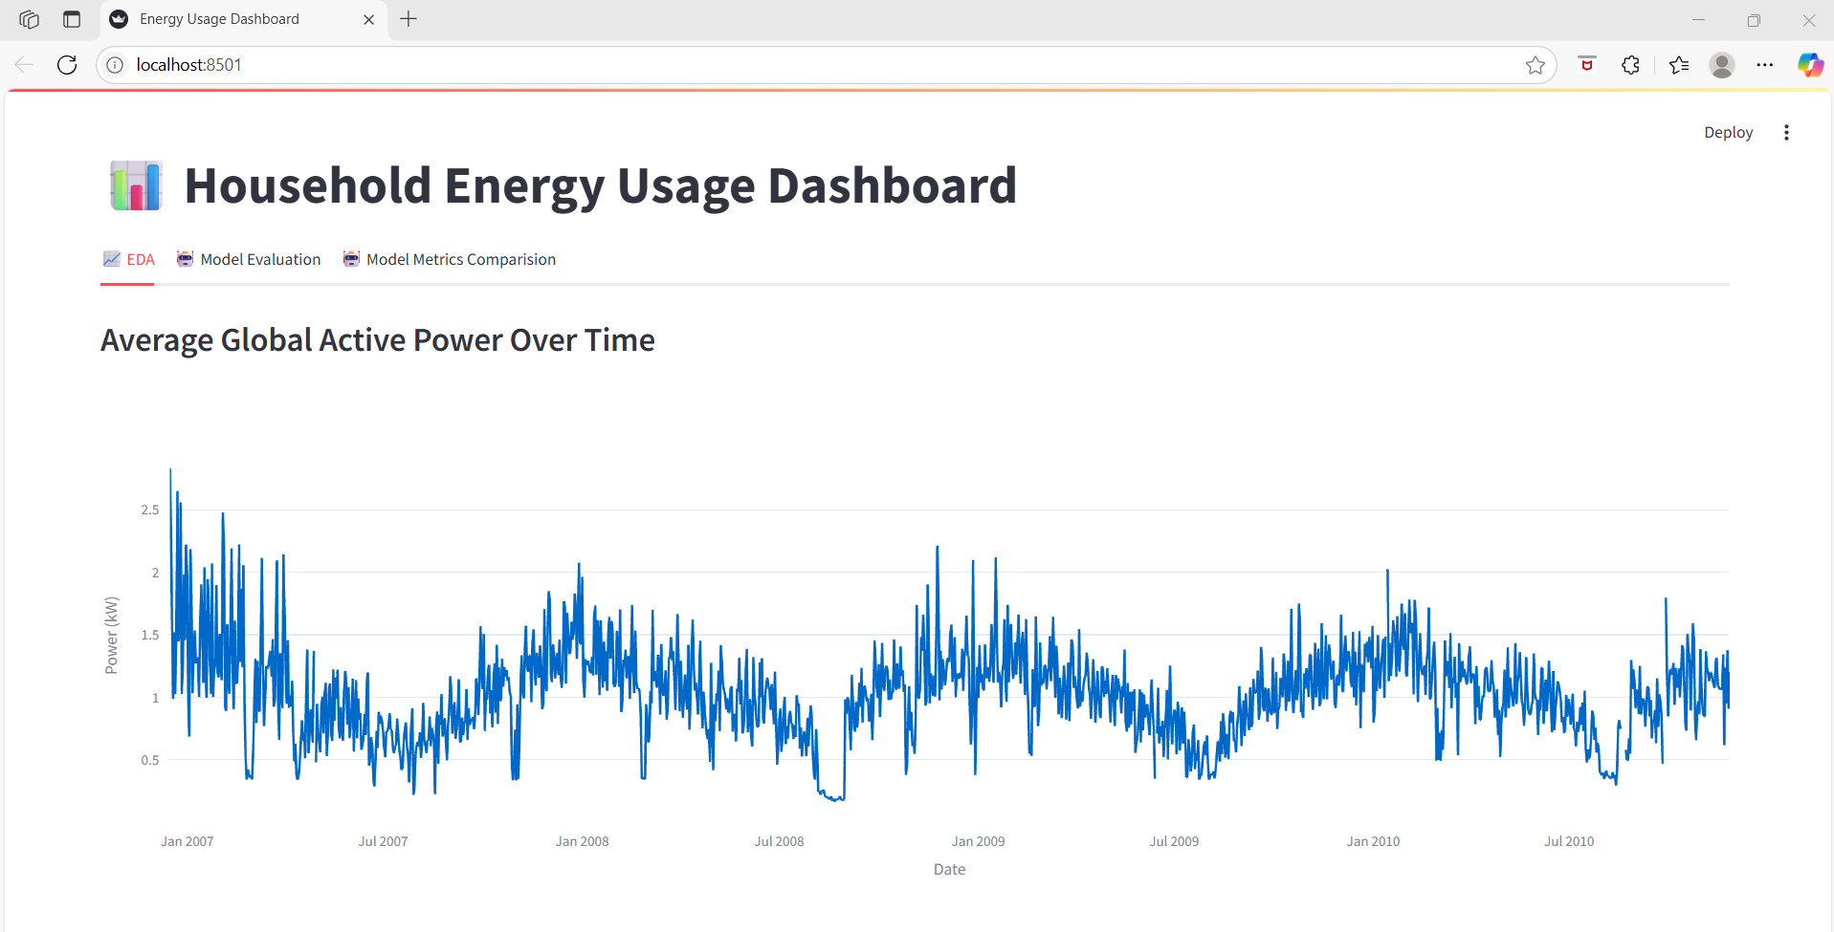
Output:

Slide 11
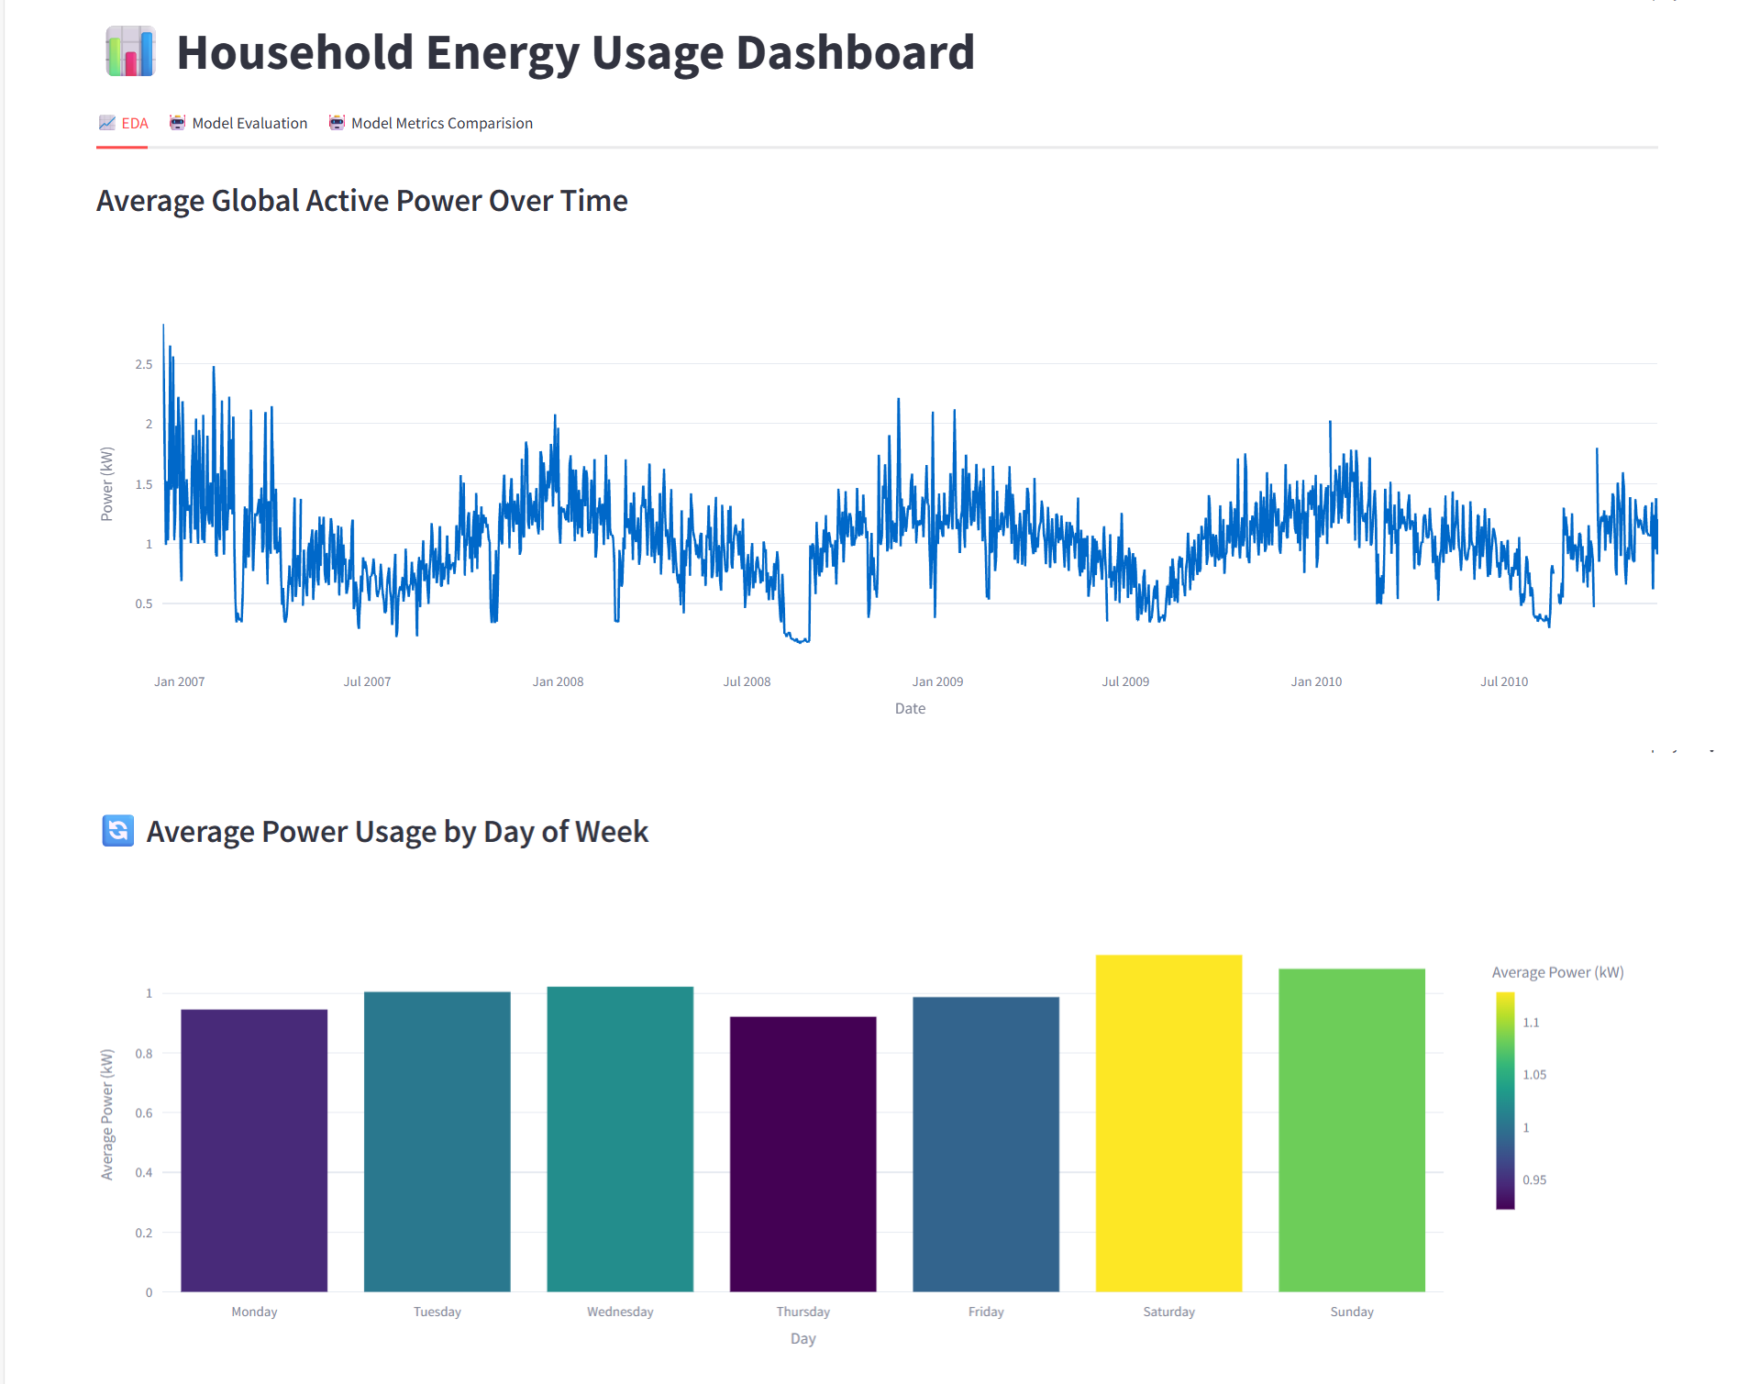
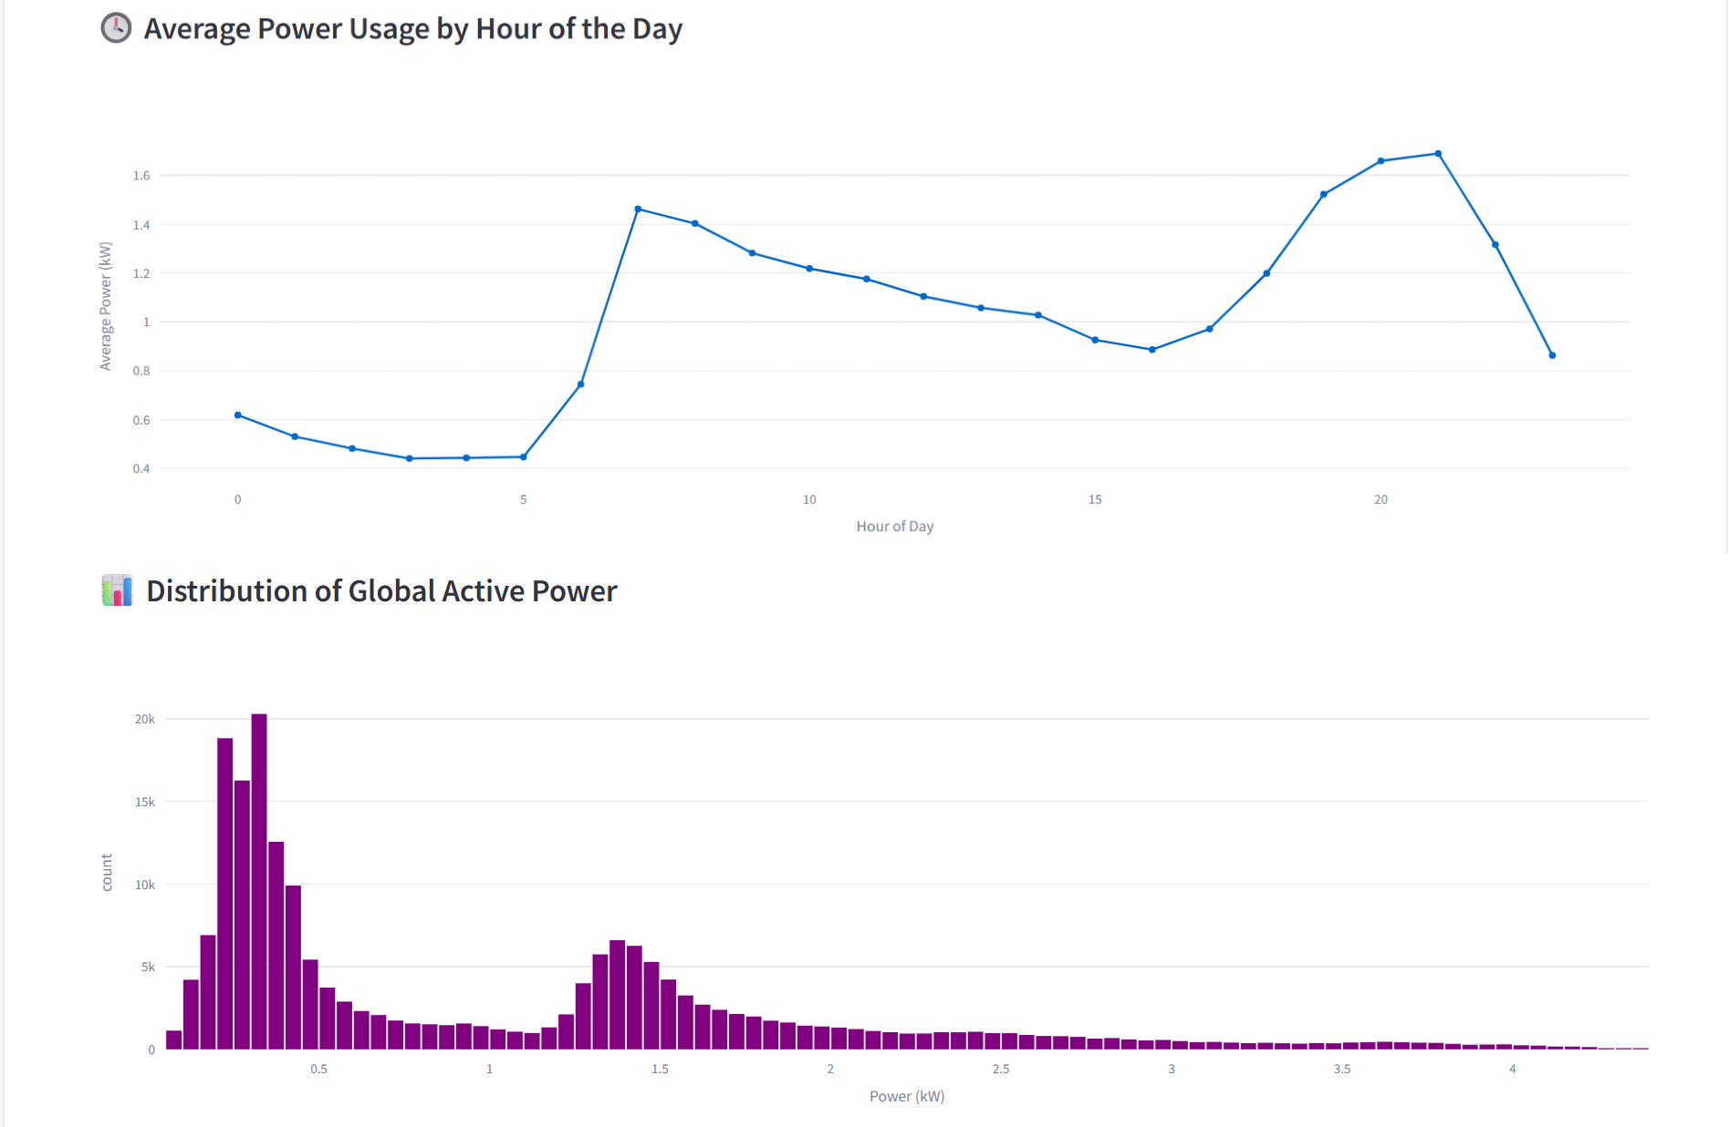
Exploratory Data Analysis

Slide 12
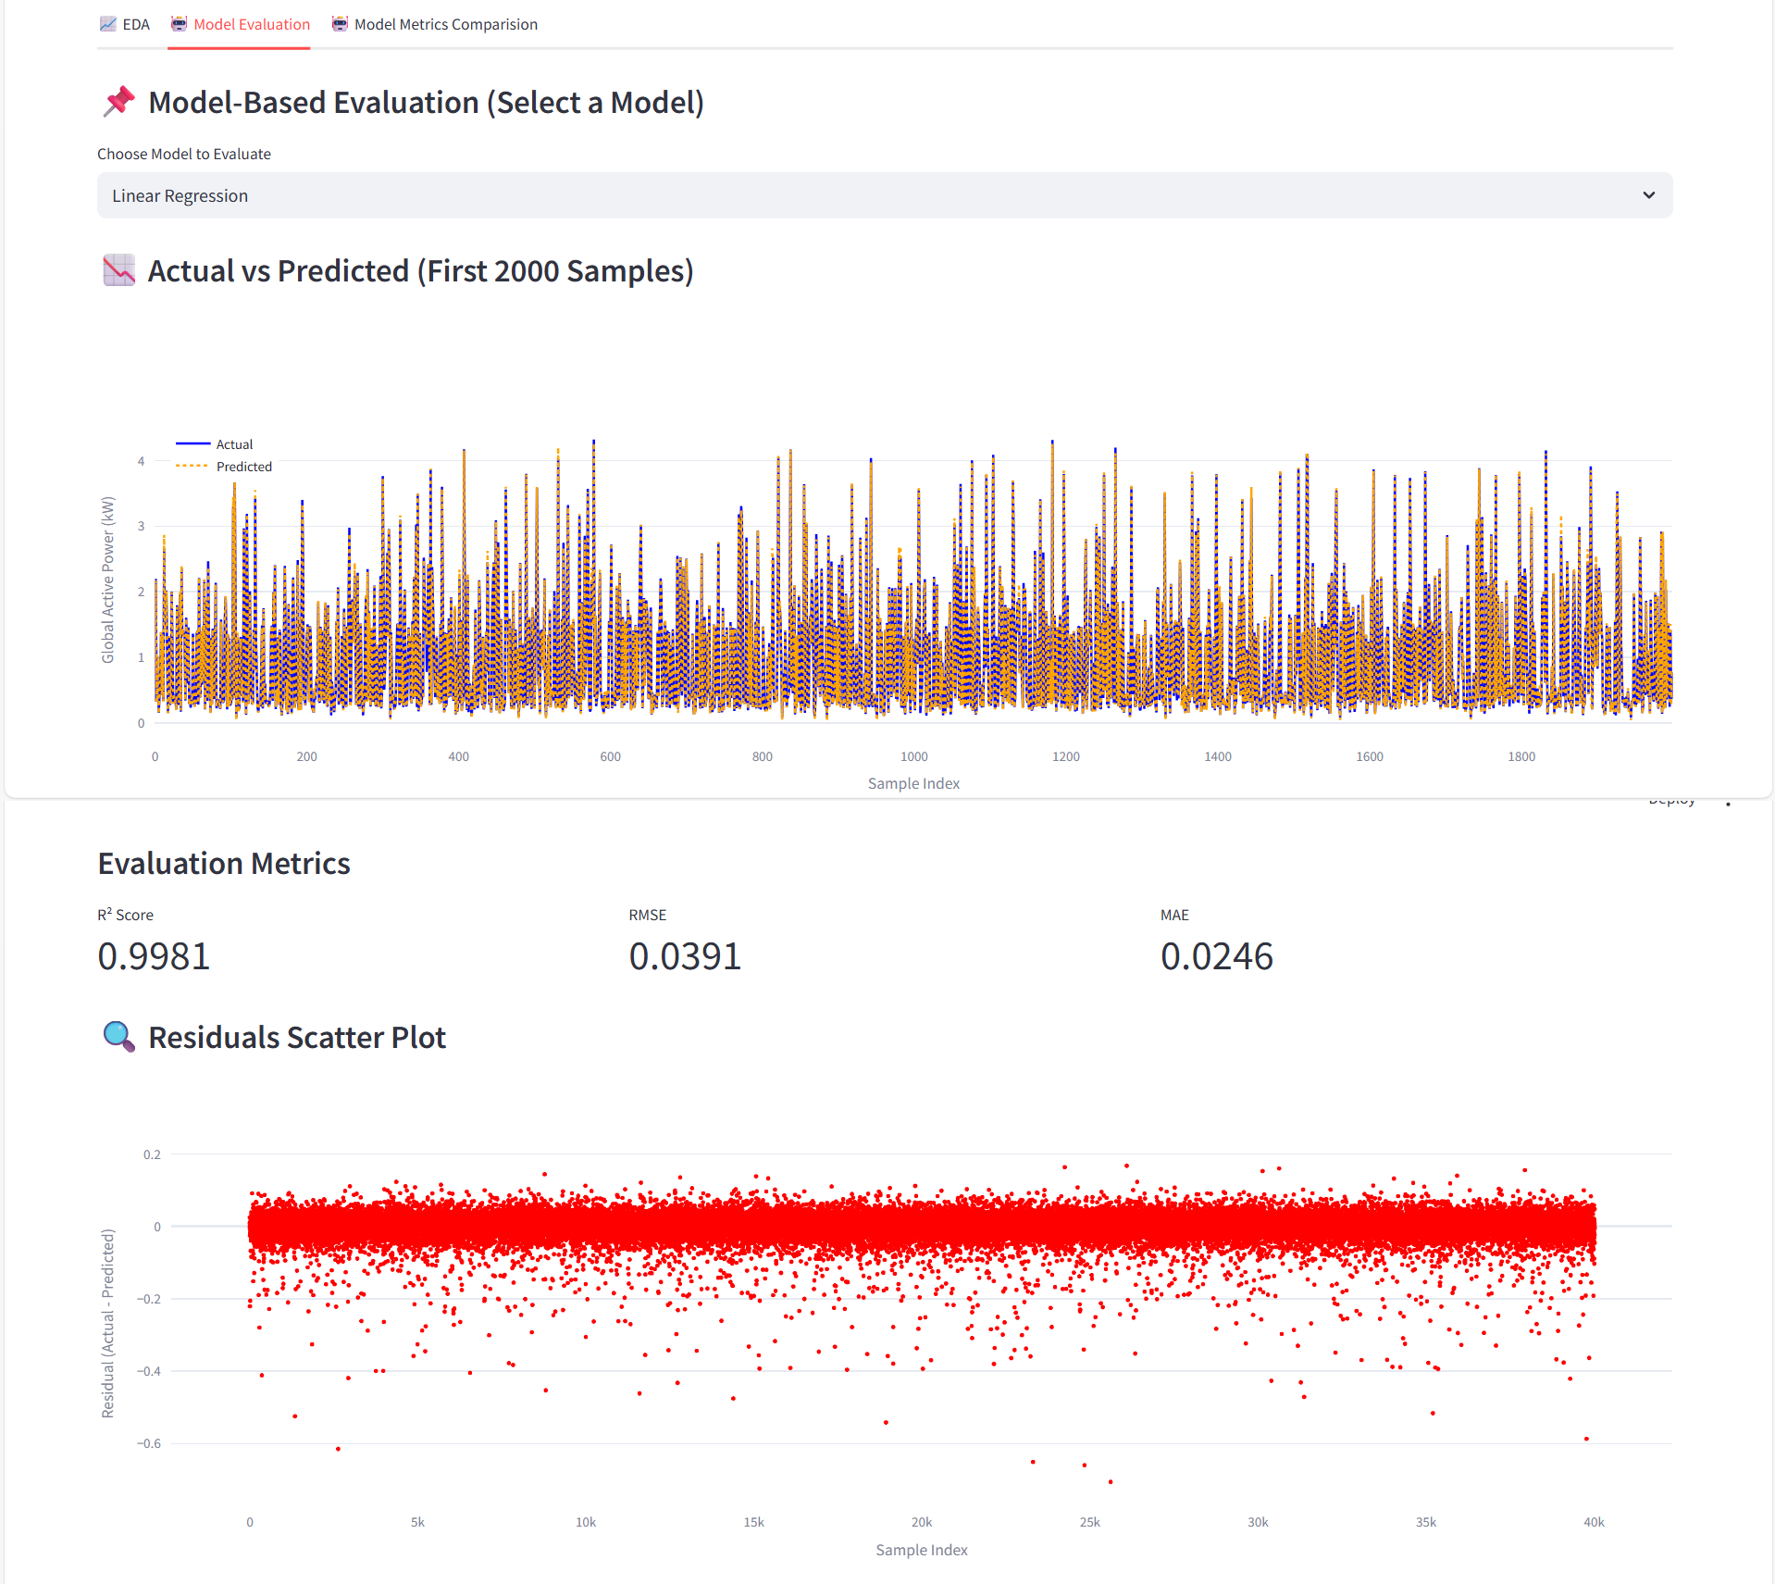
Model Evaluation:

Slide 13
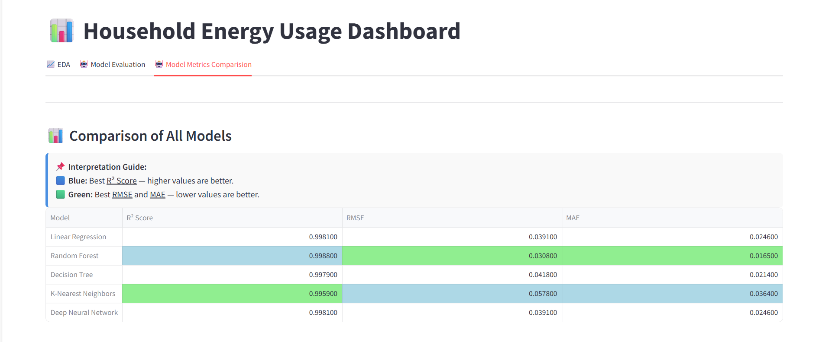
Model Metrics Comparison

Slide 14
Energy Management for Households:
Insights
Saturday dominates in power usage consumption.
Peak usage of appliances is around 7–9 AM and 7–9 PM.
Actions
Plan energy-heavy tasks on weekdays or
off-peak weekends.
Use heavy appliances (washing machine, heater, oven) during non-peak hours, reducing load and improving efficiency of such appliances.

Slide 15
Energy Management for Households:
Insights
Random Forest has lowest RMSE/MAE, making it better than other 4 models.
Models have very low percentage of error.
Actions
Prefer Random Forest for production deployment out of the 5 models used.
Confirms model is suitable for predicting data with very low error percentage.

Slide 16
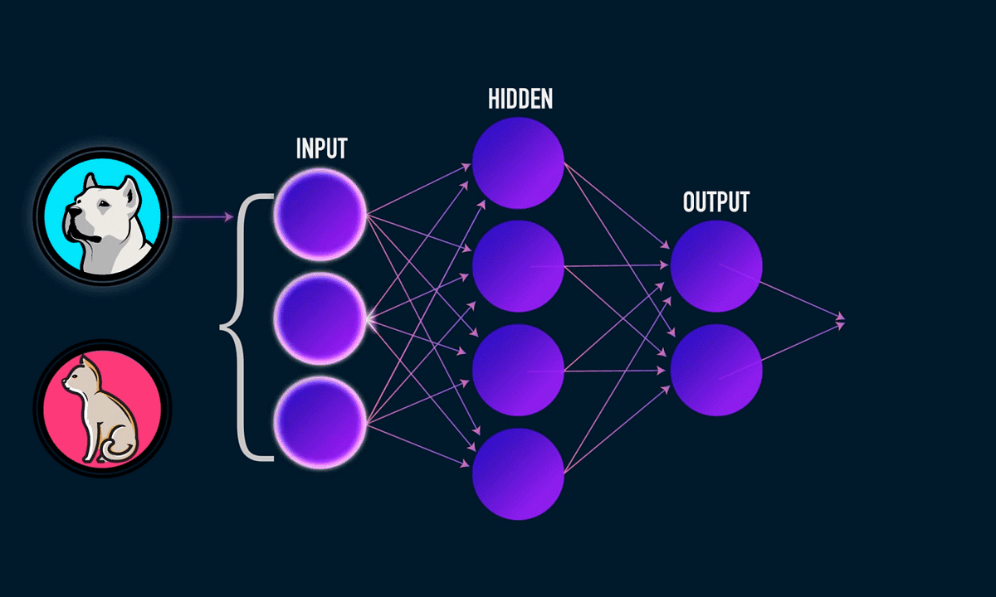
Conclusion:
This project successfully demonstrates the potential of machine learning in optimizing household energy consumption and supporting smarter energy management at scale.
Through exploratory data analysis, we uncovered clear usage patterns across time, days, and hours, offering actionable insights for both households and energy providers.
Multiple regression models were trained and evaluated. Among them, the Random Forest Regressor and Deep Neural Network exhibited the best performance with:
High R² Score
Low RMSE and MAE values
This prediction models enable:
Households to monitor and reduce energy bills by adjusting high-usage behaviors.
Energy providers to forecast demand accurately, aiding in efficient load balancing, resource planning, and smart grid integration.

Slide 17
THANK YOU

